Slide 1
Raw Material Variability Discussion – PPAR 2013 @ BMS
Facilitator: Cenk Undey, Ph.D.
Amgen

Slide 2
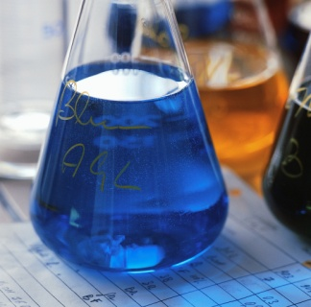
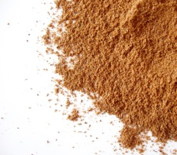
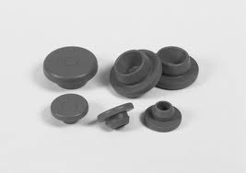
Raw Material Variation Poses Risk to Process and Product in (Bio)pharmaceutical Manufacturing
Drug Substance
Media and Buffers
Disposables
Resins and Filters
Chemicals and Excipients
Drug Product
Buffers
Chemicals and Excipients
Primary Containers (syringes, vials, cappers, stoppers)
Understanding and Managing Supply Chain is Critical

Slide 3
Discussion Points
Raw Material characterization
How much is being done up front?
How much PAT is being used for RM Characterization?
How to capture raw material variability across product lifecycle?
Continued Verification and On-going trending
How much on going trending? Evaluate correlations to the product performance?
Multivariate monitoring to capture learning for RM variation post-commercialization
How about controlling RM Variability?
Procedural controls? Specs?
Feedforward/feedback control?
Relationships with the suppliers to reduce variation?
Any prescreening (e.g., PAT-based/chemometrics based)?

Slide 4
PPAR Collaboration opportunity for electronic data transfer standards for Raw Materials
An agreed upon pharma/biopharma standard would be helpful to lower the activation energy required with the suppliers (also a standard will reduce TCO)
Proposal:
Form a working group from PPAR
Review Amgen’s method for general applicability and gather comments to generalize across bio/pharma industry requirements
Approach ASTM E55 committee to draft the standard for publication (Preliminary approach via Duncan Low was positive)

